Slide 1
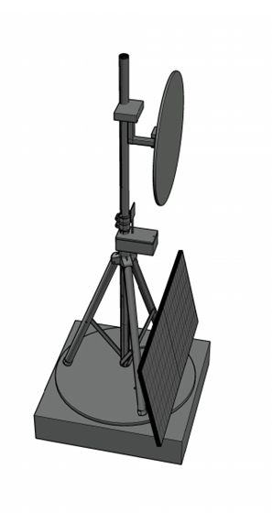
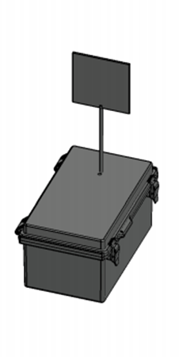





A.S.T.R.O.COM. Advanced Solar Tracking and Rover Observation Communication
Alex Fiset | Pedro Kasprzykowski | Stephen Martin | Binh Pham
Electrical Engineering | Computer Engineering | Computer Engineering | Computer Engineering

Slide 2
Motivation and Background
South Pole of Moon is area of interest for researchers
Lunar south pole has many craters that are in permanent darkness due to the sun's path across the lunar south pole's sky
Approached by FSI to solve a few problems for lunar exploration:
Permanently dark locations on the moon are difficult to explore
Lack of power infrastructure on the moon limits exploration
Permanently dark locations are a valuable location for research
Communication on lunar surface is limited
Range of communication limits exploration of craters
Limited communication infrastructure on moon

Slide 3
Motivation and Background
Proposed Solution:
A heliostat tower
To reflect light from the sun into permanently dark locations
Equipped with communication capabilities
A smaller communication beacon
Carriable by rovers
Form a communication network with rovers

Slide 4
Goals
Overall Goals (High Level)
Build a tower to handle rover communication.
Build a tower to handle sunlight diversion to targets.
Stretch Goals
P2P Networking for communication and mirror tower with rovers.
Wireless charging and/or docking station for communication tower.

Slide 5
Objectives
Mirror Tower Objectives (Lower Level)
Identify optimal sun location based on lux value from sensor.
Receive requests from communication tower using protocols.
Create a heliostat algorithm to orient towards the target with motors.
Create a self-sustainable power supply using solar and battery power.
Communication Beacon Objectives (Lower Level)
Receive requests from target through mesh network protocols.
Relay requests to mirror tower using communication protocols.
Create a small and portable tower that can be moved by rovers.

Slide 6
Specifications Table
Heliostat Tower
Minimum Temperature | -40°C
Reflector
Minimum size | 1ft diameter
Maximum size | 5ft diameter
Maximum Weight | 9kgs
Minimum Reflectivity | 90%
Response Time | 3 minutes
Tower Frame
Maximum total weight | 27kgs
Minimum Weight Capacity | 10kgs
Solar Panel
Minimum Power | 30W during sunlight hours
Maximum Voltage | 24V
Battery
Minimum Lifespan | 2 weeks without sun
Communication Tower
Minimum Enclosure Volume | 6.5"x6.5"x5"
Maximum Weight | 2kg
Minimum Network Range | 20m
Communication Rate | 2400MHz
Voltage input | 3.3V or 5V
Maximum Current Draw | 500mA
Minimum Temperature | -40°C
Latency | 1 second
Maximum Power | 5W

Slide 7
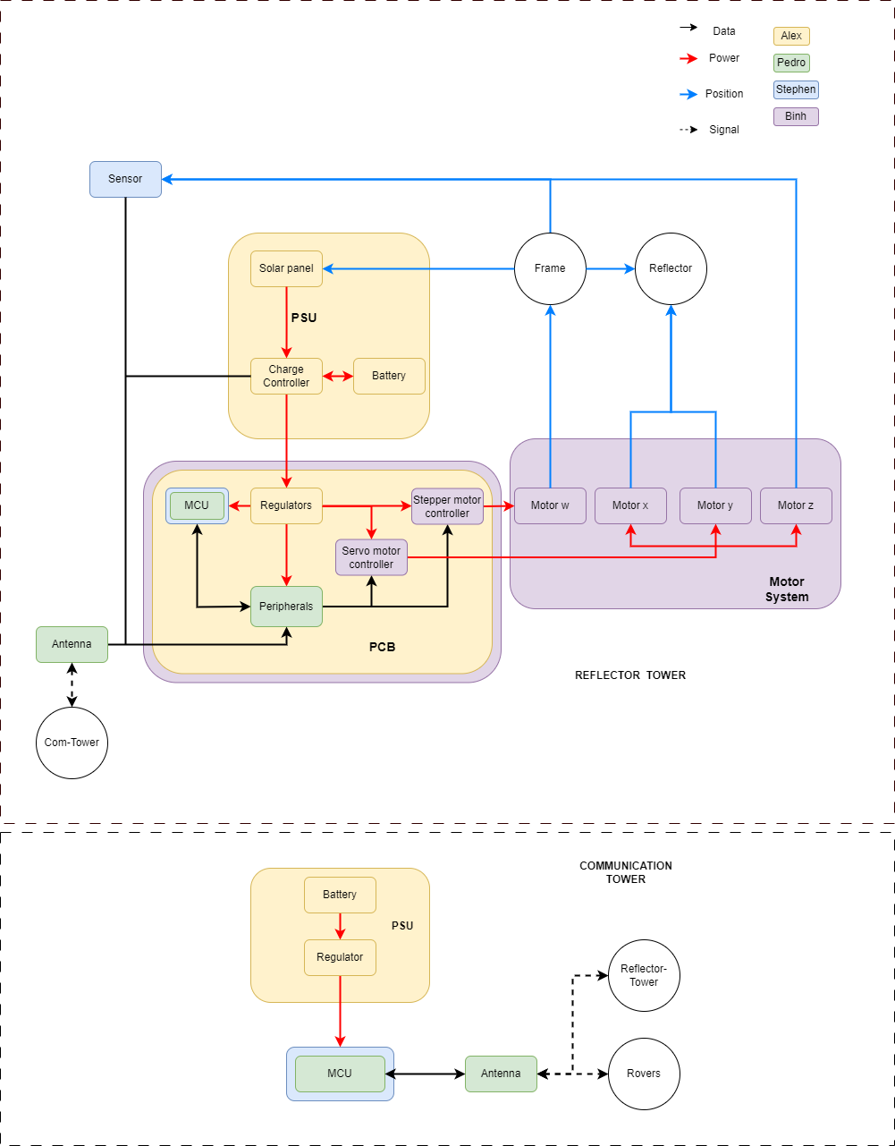
Hardware Block Diagram

Slide 8
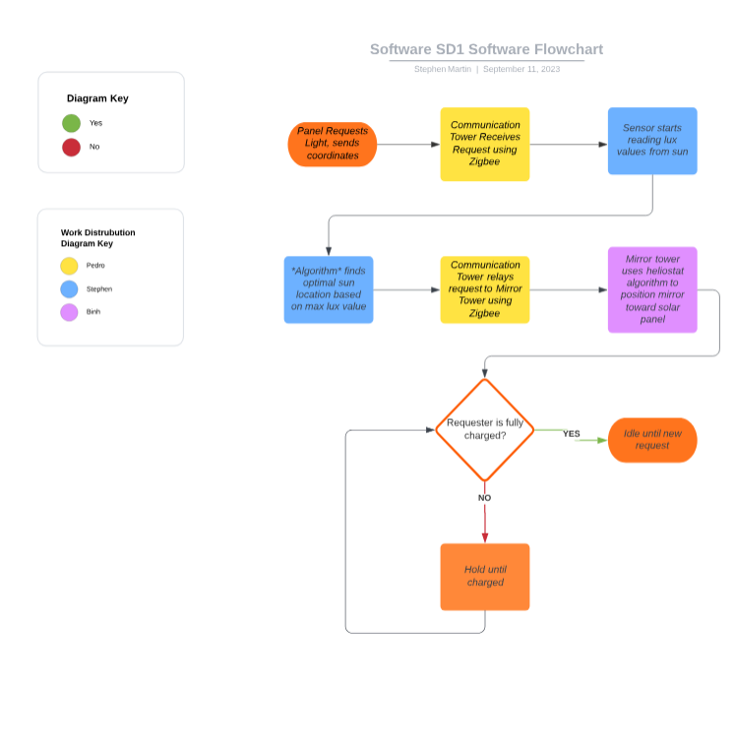
Software Block Diagram

Slide 9
Comparison and Selection of Hardware
MCU
Solar Panels
Voltage Regulation
3Charge Controller
Reflectors
Motors
Motor Controllers
Sensor
Batteries
Antenna

Slide 10

MCU
 | ESP32 | MSP430 | Raspberry Pi 0 | Arduino MKR1310 | Arduino MK1010
Cost - Processor & DevKit (USD) | 9.18 | 20 | 15 | 46 | 38.6
Wi-Fi | Yes | No | Yes | No | Yes
Bluetooth | Yes | No | Yes | No | Yes
Zigbee | Yes | No | Yes | No | No
Z-Wave | No | No | Yes | No | No
LoRaWAN | No | No | Yes | Yes | No
6LoWPAN | No | No | Yes | No | No
UART | Yes | Yes | Yes | Yes | Yes
I2C | Yes | Yes | Yes | Yes | Yes
SPI | Yes | Yes | Yes | Yes | Yes
PWM | Yes | Yes | Yes | Yes | Yes
ADC | Yes | Yes | Yes | Yes | Yes
DAC | Yes | Yes | No | Yes | Yes
Flash Memory | 4 MB | 128 KB | None | 256 KB | 256 KB
RAM | 520 KB | 2 KB | 512 MB | 32 KB | 32 KB
Operating Voltage (V) | 3.6 | 5 | 5 | 3.3 | 3.3
Current Draw (A) | 0.379 | 0.2 | 2.5 | 0.154 | 0.154
Power Consumption (W) | 1.3644 | 1 | 12.5 | 0.5082 | 0.5082
Microcontroller was chosen over FPGA, presenting characteristics that were better fits for the project such as low power consumption, cost and high amounts of documentation.
ESP32 had the best combination of low cost, low power and networking capabilities and all connections required.
Criteria | Microcontroller | FPGA
Environmental robustness | ✓
Low power consumption | ✓
Parallel processing |  | ✓
Ease of use | ✓
Processing power |  | ✓
Cost | ✓
Scalability |  | ✓
Integration/Peripherals | ✓
Documentation | ✓

Slide 11
Solar Panels
Solar Panel Technology | Efficiency | Low-Light Perf. | Temp. Tolerance | Radiation Resistance | Degradation | Weight & Size
Monocrystalline | High | Excellent | Good | Good | Low | Relatively heavier
Polycrystalline | Moderate | Good | Good | Good | Low to Moderate | Moderate
Thin-Film | Low | Varies | Good | Varies | Moderate to High | Lightweight & Flexible

Slide 12
Solar Panels
Model | RNG-50D-SS | HQST-50P-US | SP-52-L
Brand | Renogy | HQST | Solbian
Technology | Monocrystalline | Polycrystalline | Monocrystalline
Price | $ 59.99 | $ 65.99 | $ 499.00
Pmax at STC | 50 W | 50 W | 52 W
Voc | 22.3V | 23.3V | 10.9V
Vmp | 18.6V | 19.8V | 9.1V
Imp | 2.69A | 2.53A | 5.7A
Isc | 2.94A | 2.63A | 6A
Weight | 7.7 lbs | 8.4lbs | 1.8lbs
Dimensions (inches) | 22.9 x 20 x 1.2 | 25.9 x 18.6 x 1.2 | 43.7 x 11.49 x 0.1
Temp Coefficient of Pmax (%/degC) | -0.37 | -0.37 | -0.38

Slide 13
Voltage Regulation
Specifications | Linear Regulators | Switching Regulators
 |  | Buck | Boost | Buck-Boost
Efficiency | Moderate | High
Heat | Moderate | Low
Voltage Output | Step-Down | Step-Down | Step-Up | Up or Down
Output Ripple | Low | Low | High | Low
Complexity | Low | Moderate | Moderate | High
Cost | Low | Moderate | Moderate | High

Slide 14
Voltage Regulation
Model | LM1085IT-5.0/NOPB | DROK MiniBuck Converter | LM2596 | TPS54JA20
Brand | Texas Instruments | DROK | Texas Instruments | Texas Instruments
Input Voltage | 2.6-26V | 2.5-24V | 3-40V | 2.7–16V
Output Voltage | 3.3 or 5 | 3.3 or 5 | 1.5 to 35 | 0.5 to 5.5V
Output Current | 3A | 3A | 3A | 12A
Price | 2.19 | 1.97 | 1.495 | 0.65
Type | LDO Buck | Buck | Buck | Buck

Slide 15
Charge Controller
Two broad categories of Solar Charge Controllers:
PWM
Basic pulse width modulation
Lower efficiency
Cheaper
MPPT
Tracks highest power producing operating point
Higher efficiency
Typically, more expensive

Slide 16
Charge Controller
Model | BQ25798RQMR | SR11004 | Adventurer
Brand | Texas Instruments | SMARAAD | Renogy
Input Voltage | 24V max | 26V max | 50V max
Output Voltage | 18.8V max, Programmable | 12/24V | 12/24V
Output Current | 5A | 10A | 30A
Price | 6.25 | 39.99 | 59.99
Power | Not Specified | 260W | 1500W
Type | MPPT | MPPT | PWM
Programming MPPT | I2C | Not Specified | NA
MPPT Type | Sets Voltage to % of Voc | Not Specified | NA
Charge controls | Programmable | Battery Chemistry presets | Preprogrammed depending on chemistry

Slide 17
Reflectors
Material Chosen to fabricate:
Aluminum has high heat resistance, durable, and high reflectivity in the moon environment.
Mylar increase reflectivity instead of glass which has higher heat change resistance and won’t crack, which reduces quality of refection
Proof of concept: plywood as cheaper alternative and easier to fabricate.

Slide 18
Motors
Stepper motor: Nema 34 robustness and strong torque to control the rotation of the whole tower. Can be used on DC system
Incorporated gearbox to increase movement range and control for stepper motor.
Servo Motors: a cheaper alternative for smaller part movements.
Types of Motors | DC Brush | DC Brushless | AC | Stepper | Servo
Financial Cost | Small: $5-$50 Medium: $20-$100 | Small: $10-$100 Medium: $100-$500 | Small: $50- $200 Medium: $200-$2,000 | Small: $10-$50 Medium: $50-$200 | Small: $50-$200 Medium: $200-$1000
Size | ~8mm-35mm | ~13mm-35cm | ~10cm-30cm | ~0.4cm-20cm | ~0.4cm-10cm
Torque | 0.36-160 nNm | 4-400 nNm | 203000Ncm-610000Ncm | 10-10000Ncm | 10-1000Ncm
Speed | 5,000 to 14,000 rpm | 100,000 rpm | 1800-3600 rmp | Low | High
Voltages requirement | 4.5V/4.5V/7.0V | 4-24V | 115V/208V/230V | 3V-100V | 3V-100V
Durability | High | High | High | High | Low
Weight | 0.5-160g | 10-1000g | 750g | 150-5000g

Slide 19
Motor Controllers
Stepper Controller DRV8834, cheap and can handle the amperage provided by the system.
PCA9685 PWM: Design specific for servo and can control all three servos planned in the system, compatible with ESP32 C6 and run on I2C protocol.

Slide 20
Batteries
Specifications | Lead Acid | NiCd | NiMH | Li-ion
 |  |  |  | Cobalt | Manganese | Phosphate
Specific Energy | 30-50 | 45-60 | 60-120 | 150-250 | 100-150 | 90-120
Internal Resistance | Very low | Very low | Low | Moderate | Low | Very low
Cycle Life | 200-300 | 1000 | 300-500 | 500-1000 | 500-1000 | 1000-2000
Self-Discharge/month at RT | 5% | 20% | 30% | < 8%
Operating Temperatures | -20 to 50 C | 0 to 45 C | 0 to 45 C | 0 to 45 C
Maintenance Requirements | 3-6 Months topping charge | Full discharge every 90 days |  | Maintenance free
Safety Requirements | Thermally stable | Thermal stable, fuse protection |  | Protection circuit mandatory
Cost | Low | Moderate |  | High

Slide 21
Batteries
Model | ML5-12 | HW-4F7 | PQ12V/6AH
Brand | Mighty Max Battery | Howell Energy | Power Queen
Voltage | 12 | 12 | 12.8V
Amp Hour | 5 | 7 | 6
Technology | SLA AGM | LiFePO4 | LiFePO4
Price | 16.99 | 32.99 | 19.59
Temperature Rating | -20 to 50 | -20 to 70 | Not Specified
Weight | 3lbs | 1.9lbs | 1.8lbs
Dimensions | 3.5 x 2.8 x 4.2 | 5.9 x 2.6 x 3.7 | 5.9 x 2.6 x 3.7
Charging Requirements | CV | CC 3.5A, CV 14.6V, Built-in BMS | Not Specified, Built in BMS

Slide 22
Sensor
Sensor Final 4 Options:
VL6180X and SI1145 include IR which is not needed
MAX44009 only has breakout board; does not work for PCB
VEML7700 best choice for price/ability
 | VL6180X | MAX44009 | SI1145 | VEML7700
Cost (USD) | $14.49 | $5.96 | $9.95 | $4.95
Measuring Principle | TOF/IR Laser Photodiode | Photodiode | IR-LED Photodiode | Photodiode
Max Lux | 100000 | 188000 | 128000 | 120000
Ambient Light Sensing | Yes | Yes | Yes | Yes
IR Sensing | No | No | Yes | No
UV Sensing | No | No | Yes (extrapolated) | No
Operating Voltage (V) | 3 | 3.6 | 3.6 | 3.6
Operating Current (mA) | 0.3 | 0.0003 | 7 | 0.0045
I2C | Yes | Yes | Yes | Yes
SMBus | No | Yes | No | No
ADC | Yes | Yes | Yes | Yes
Size (mm^2) | 234 | 4 | 360 | 15.98
Operating Temperature ( C ) | [-20 - 70] | [-40 - 85] | [-40 - 85] | [-25 – 85]
C/C++ Libraries | Yes | Yes | Yes | Yes

Slide 23
Comparison and Selection of Software
Vectoring and Positioning / Solar Tracking Algorithm
Communication technologies
Development Environment: Languages and Repositories

Slide 24
Development Environment: Languages and Repositories
Programming Languages
C: best choice for MCU programming, low-level
Java: best for object-oriented programming, low-level
Python: best for existing libraries, high-level
Choice: C
Repositories
GitHub: most popular repo, widely used among many software devs
Bitbucket: Git based repo, includes task scheduling and team goal software
Choice: GitHub

Slide 25
Vectoring and Positioning / Solar Tracking Algorithm
Algorithms | Heliostat | Kalman Filtering | Skyview Factor | Ray Tracing | Two-axis Solar Tracking System | Sun tracking Photodiode
Financial Cost | Open Source | Ambiguous | Open Source | Not available | Open Source | No available
Sensor | Ambient Light | Ambient Light | Ambient Light | Ambient Light | Ambient Light | Photodiode
Algorithm code library | Available on GitHub | Available in python | Available on GitHub | Available in Research paper | Available in GitHub | Not available
Efficiency | High | Low | Medium | Medium | High | High
MCU compatibility | Good (C Language) | Fair (Python) | Bad (R Script) | Good (C Language) | Good (C Language) | Bad (No code)
Additional Requirements | Change to an algorithm to change light measuring location | Compass Reading or gyroscopic data

Slide 26
Antenna
The combination of the certain gain range, circular polarization, high-efficiency and wideband characteristics made patch and helical antenna types the ideal choices.
The PC140’s circular polarization while also being above average in gain and efficiency made it the preferred antenna product.
 | Dipole | Patch | Reflector (Parabolic) | Yagi – Uda | Helical Antenna | Aperture (Horn)
Gain (dBi) | 1.76-7 | 0.5 -10 | 10 - 40 | 5 – 20 | 3 – 15 | 10 – 25
Polarization | Linear | Linear/ Circular | Circular | Linear | Circular | Linear/ Circular
Efficiency | High | High | High | High | High | Very High
Bandwidth | Narrowband | Wideband | Narrowband | Narrowband | Wideband | Narrowband
Directivity | Omni - directional | Omni - directional | Highly Directional | Highly Directional | Directional | Highly Directional
 | PC140 | WPC.25A | FXP74 | PC17 | FXP70
Average Gain (dB) | -1.92 | -1.14 | -2 | -3.6 | -2
Peak Gain (dBi) | 1.67 | 5.15 | 4 | .9 | 1.1
Efficiency (%) | 64 | 76.9 | 50 | 44 | 63.7
VSWR | <2 | <2 | <2 | <1.5 | <1.5
Polarization | RHCP | Linear | Linear | Linear | Linear
Cost (USD) | $27.26 | $9.21 | $7.69 | $16.60 | $27.09

Slide 27
Communication technologies
The combination of low power consumption, suitable range, options for frequency and high scalability made Zigbee the ideal communication technology to implement.
Criteria | Wi-Fi | LoRaWAN | Bluetooth | 6LoWPAN | Zigbee | Z-Wave
Range (m) | 45 | 15000 | 10 | 100 | 980 | 800
Data rate | 54 Mbps | 50 Kbps | 1 Mbps | 250 Kbps | 250 Kbps | 100 Kbps
Power consumption | 30 uA-250 mA | 1 uA-16 mA | 9 uA-39 mA | 0.3 uA-35 mA | 12 uA- 54 mA | 1 uA-23 mA
Max devices | 255 | 120 | 3-4 | 100 | 100 | 232
Scalability | ✓ | ✓ | ✖ | ✓ | ✓ | ✓
Frequency | 2.4/5/6 GHz | 902.3-914.9 MHz | 2.4 GHz | 2.4 GHz | 915 MHz/2.4 GHz | 908-916 MHz

Slide 28
Hardware Design
Design two separate towers, each with their own design constraints
Majority of focus is on heliostat tower, as it is more complex
Schematics and PCB designs
Heliostat structure
Tripod on a "Lazy Susan"
Communication Beacon
Antenna on an enclosure

Slide 29
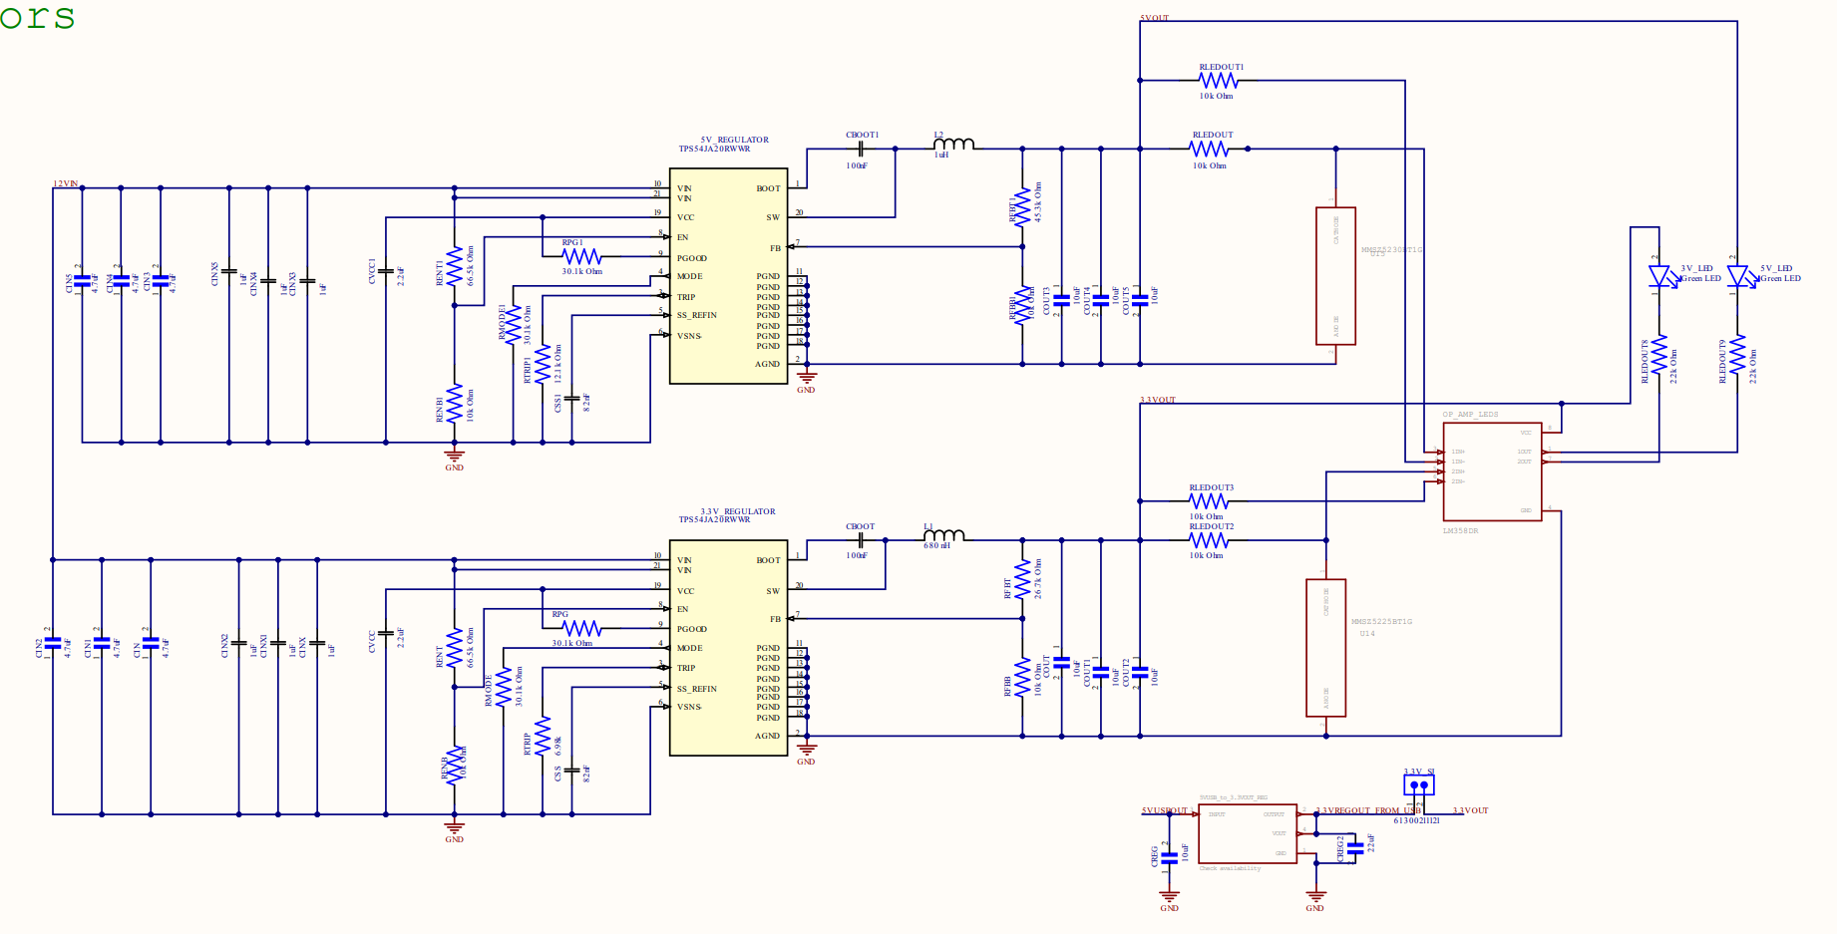
Power Delivery/ Electrical Power System

Slide 30
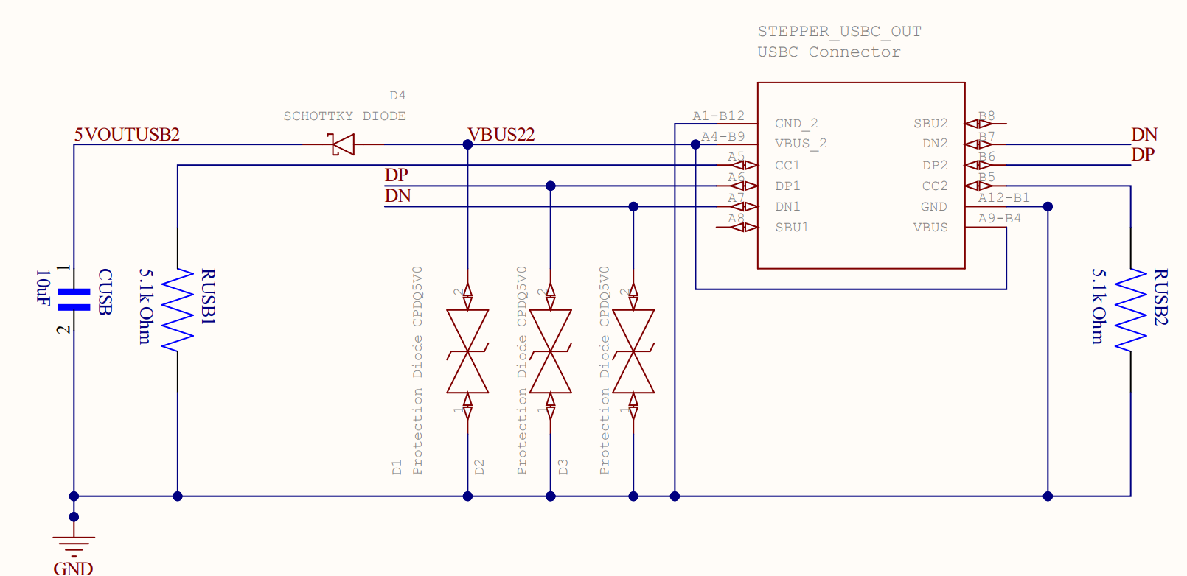
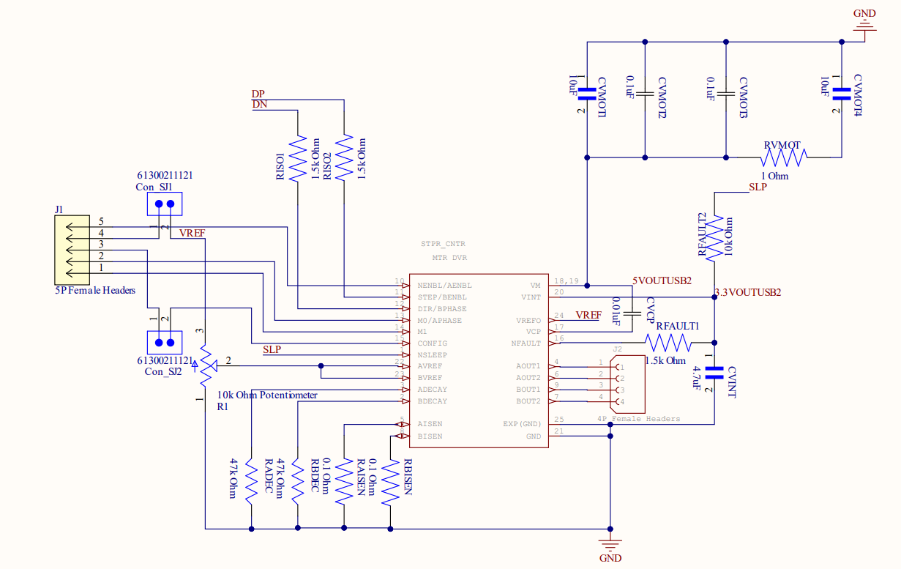
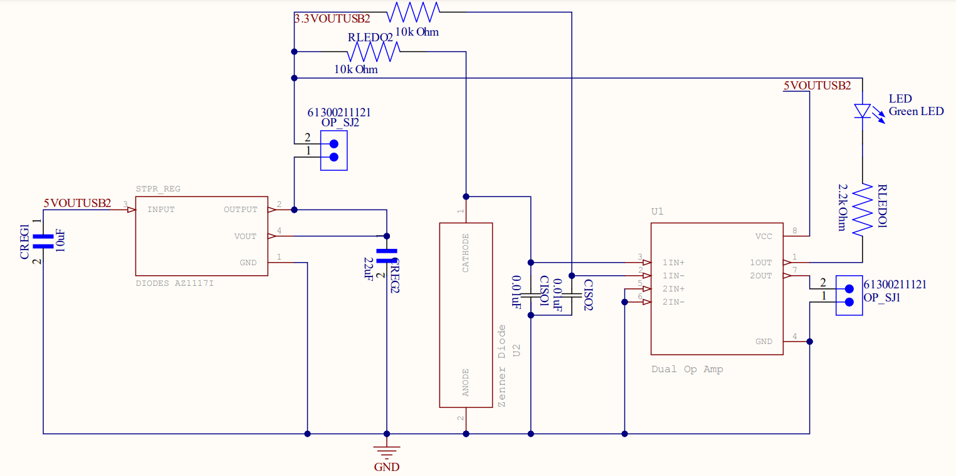
Stepper Motor Controls

Slide 31
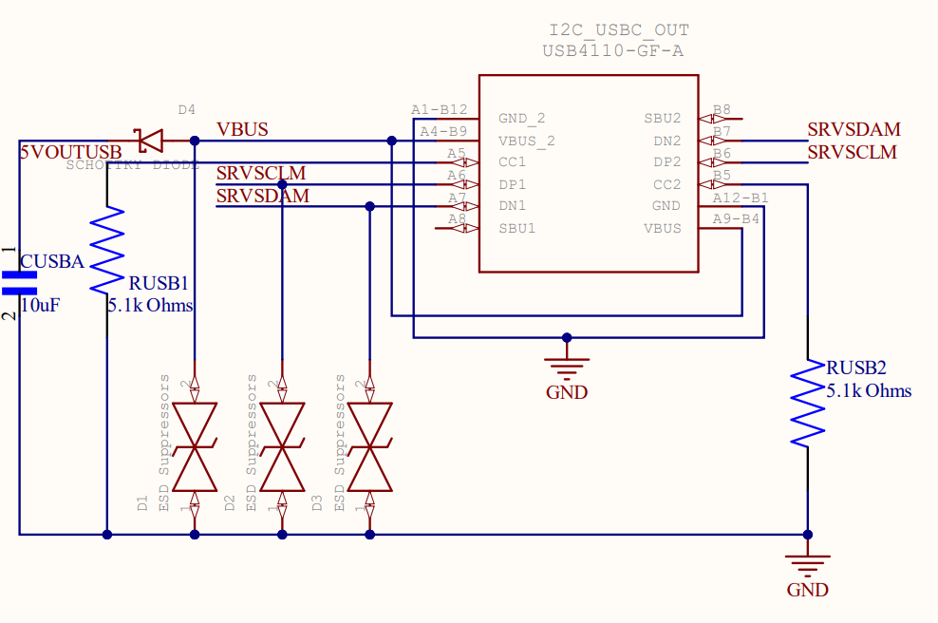
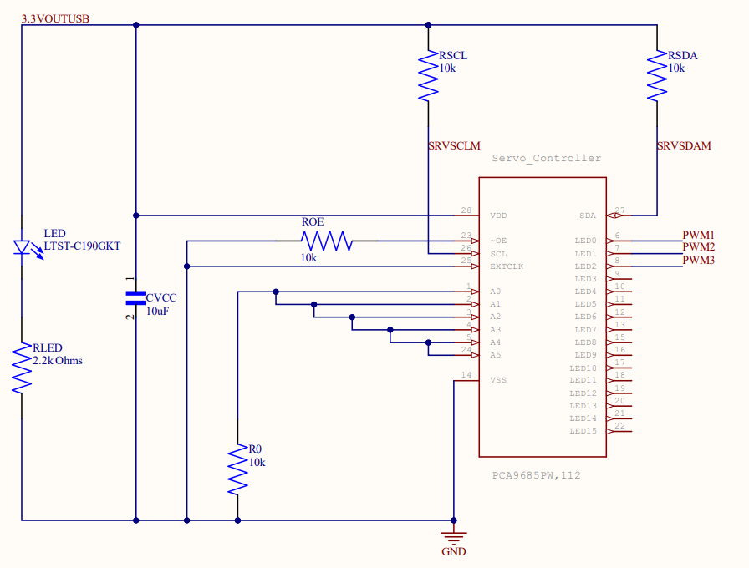
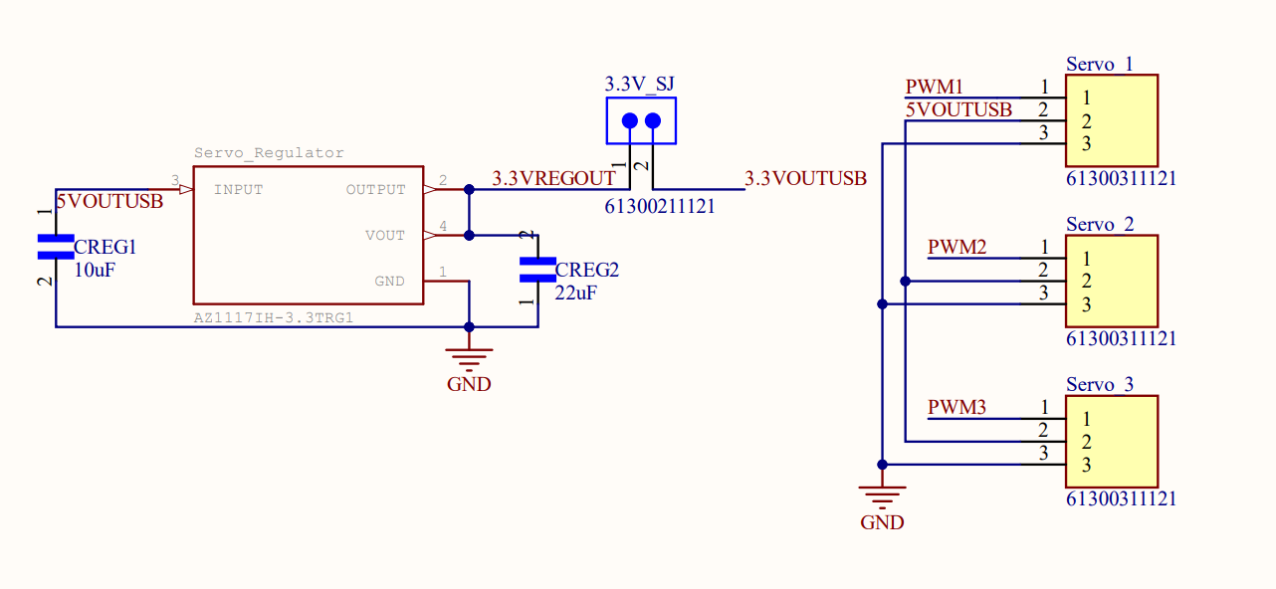
Servo Motor Controls

Slide 32
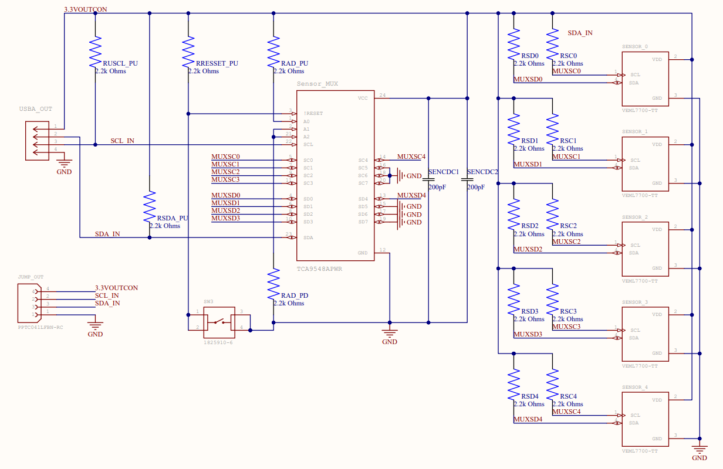
Sensor Control

Slide 33
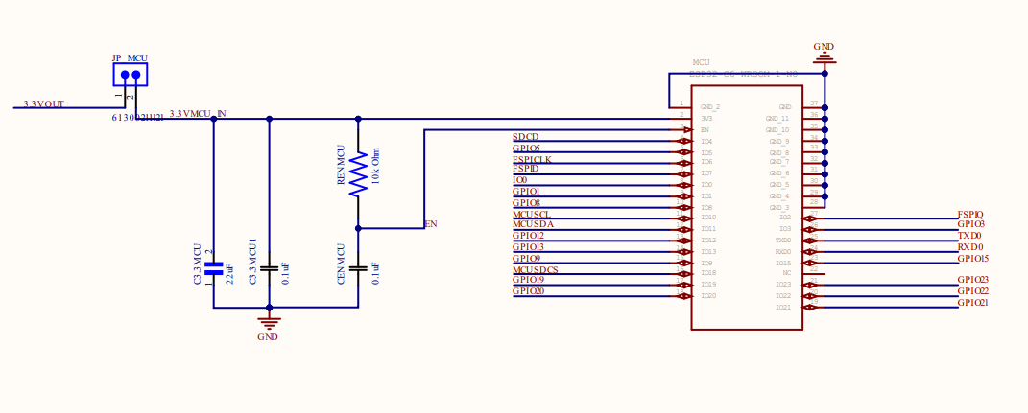
MCU System

Slide 34
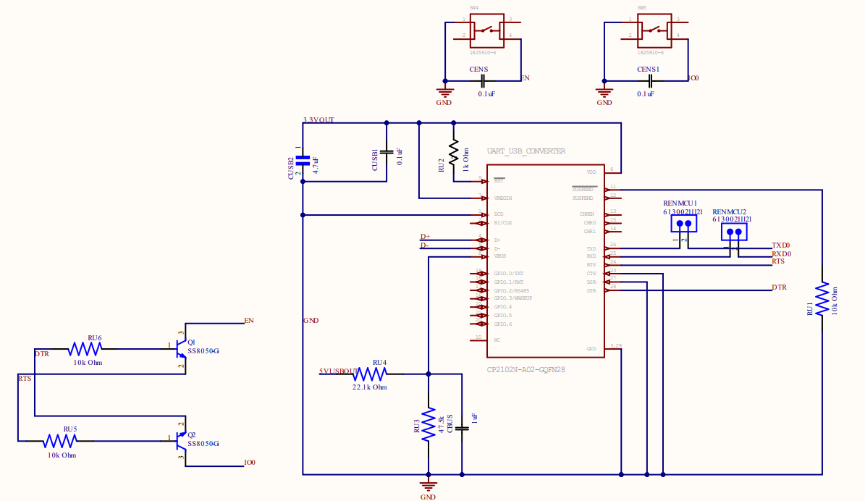
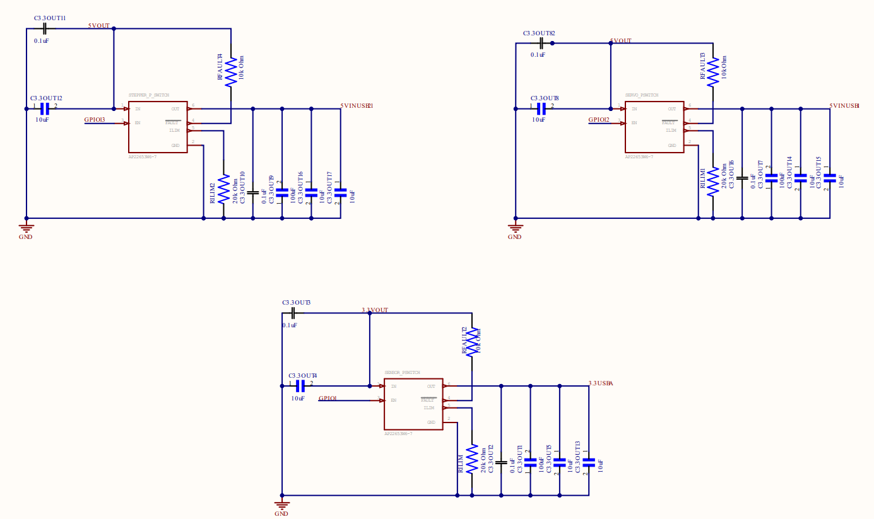
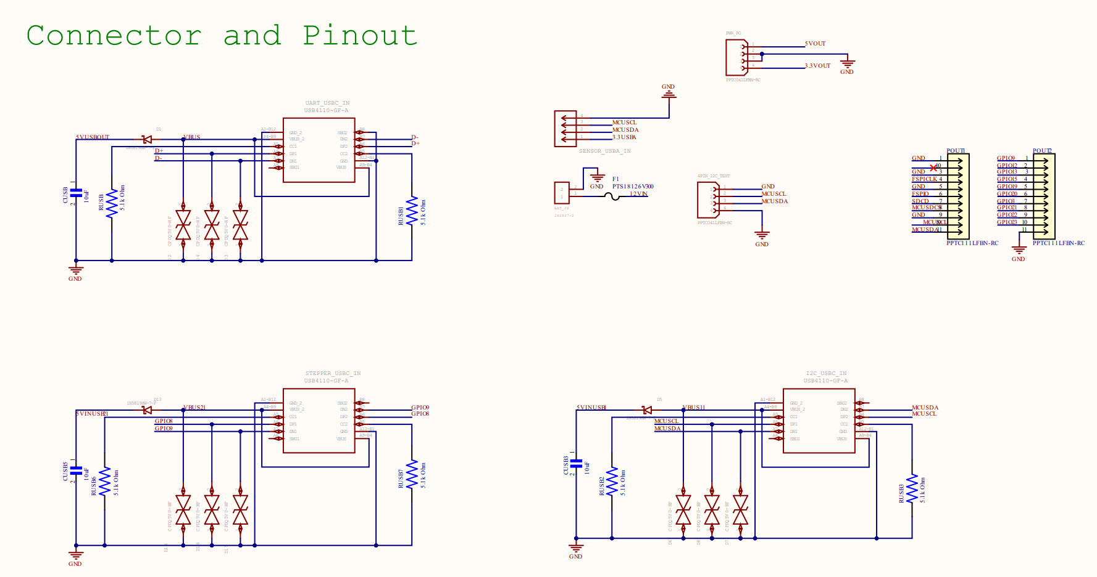
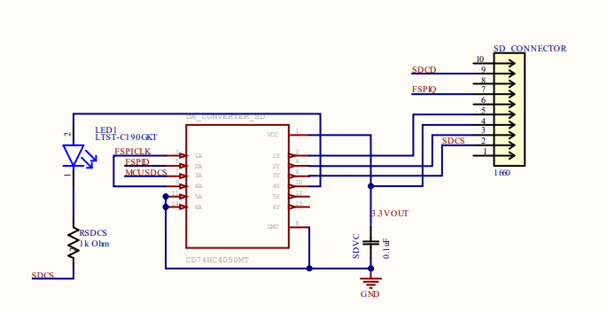
Lower-Level Subsystem

Slide 35
Software Design
Details on software design for the overall system which includes:
Communications through the mesh network
Collecting sensor information
Positioning reflector to deliver sunlight to target
Represented with software diagrams

Slide 36
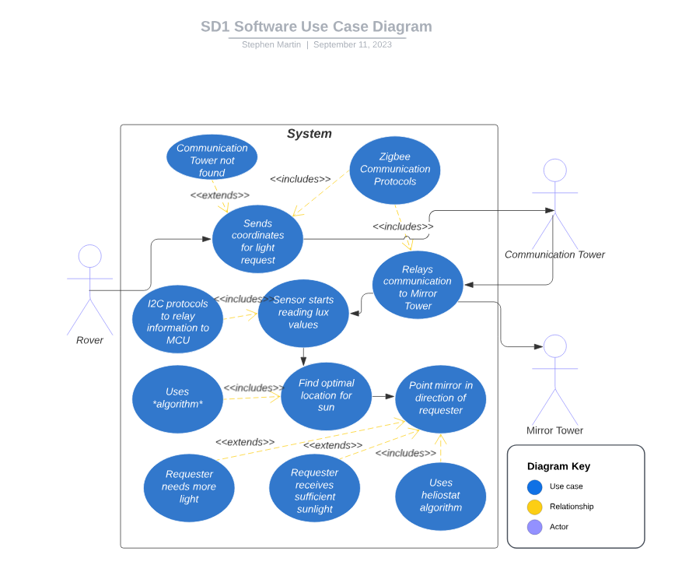
Case Diagram

Slide 37
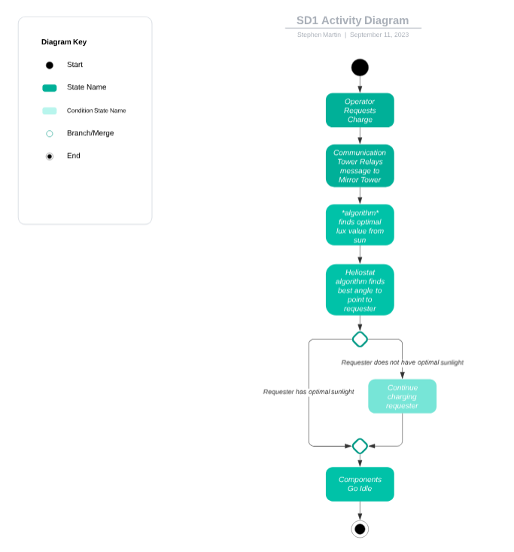
Activity Diagram

Slide 38
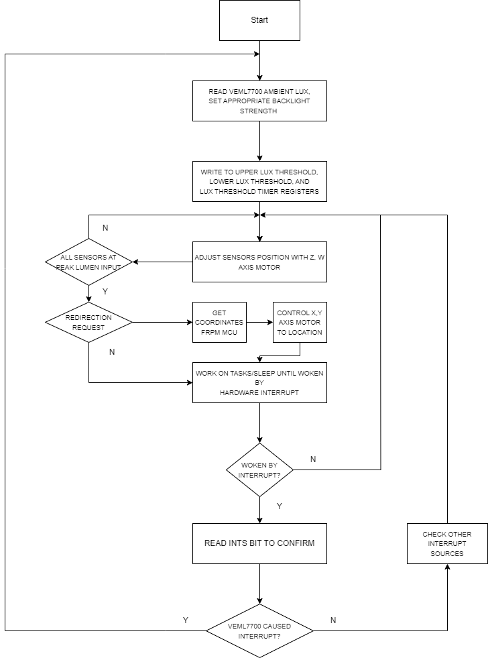
Motor positioning of Reflector based on light intensity algorithm.

Slide 39
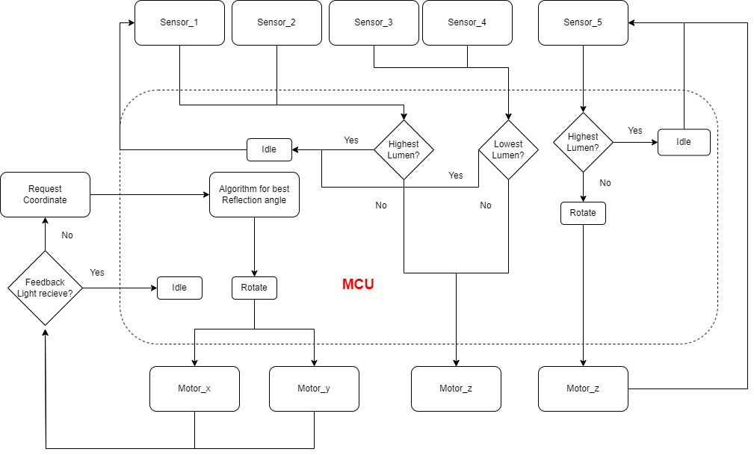
Motor positioning of Reflector based on light intensity algorithm

Slide 40
Power Control Algorithm
Goal was to reduce power consumption when the sun would not be visible
Reducing usage of non-essential components during these times would preserve battery charge
Component | Essential/Non-Essential | Low-Power Considerations
MCU | Essential | Low-Power Mode, only essential functions
Antenna | Essential | Receive only
Sensors | Essential | Sensors will be turned on periodically
Stepper Motor | Non-Essential
Servo Motors | Non-Essential

Slide 41
PCB Design
MCU
Sensors
Stepper Motor Controller
Servo Motor Controller

Slide 42
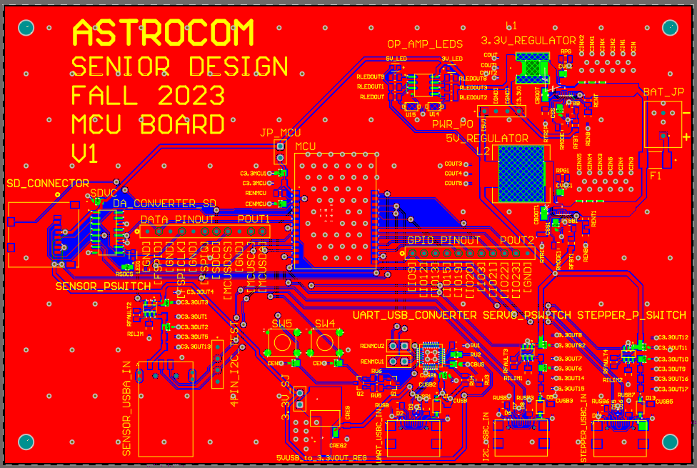
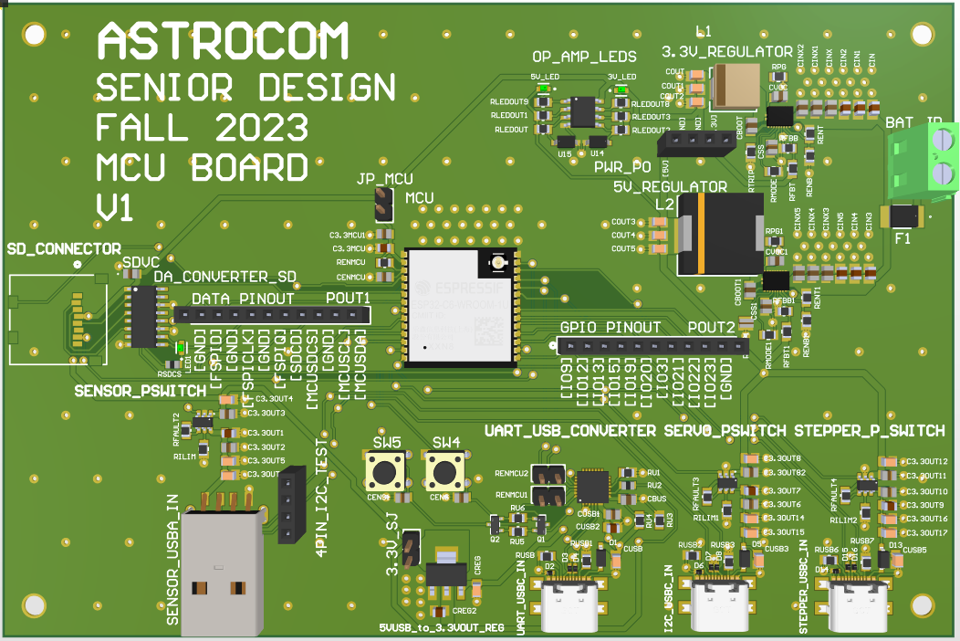
MCU PCB

Slide 43
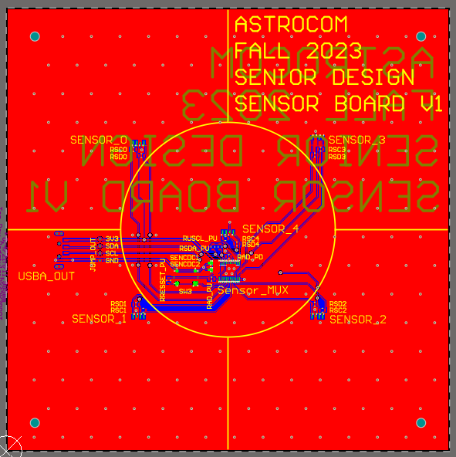
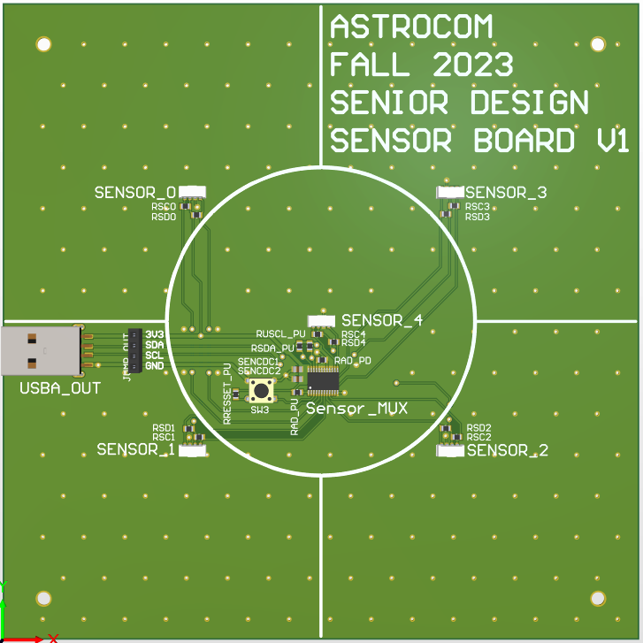
Sensors PCB

Slide 44
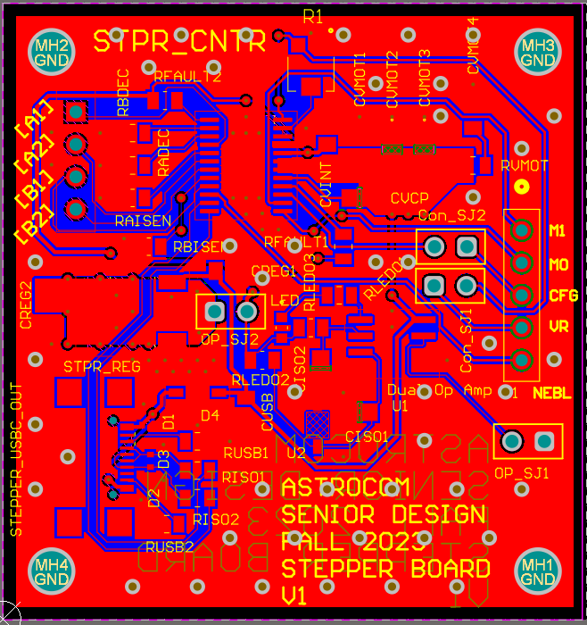
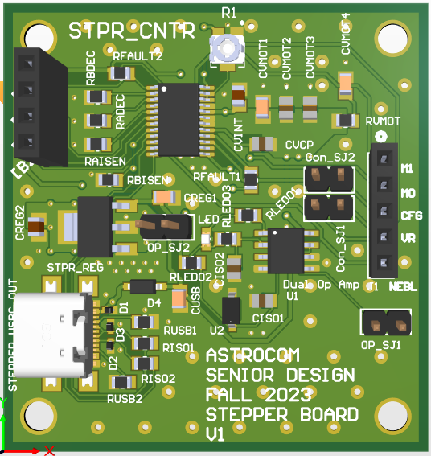
Stepper Motor Controller PCB

Slide 45
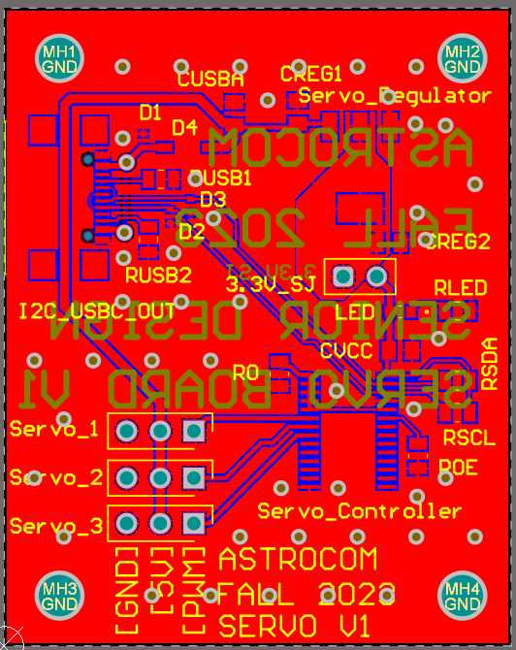
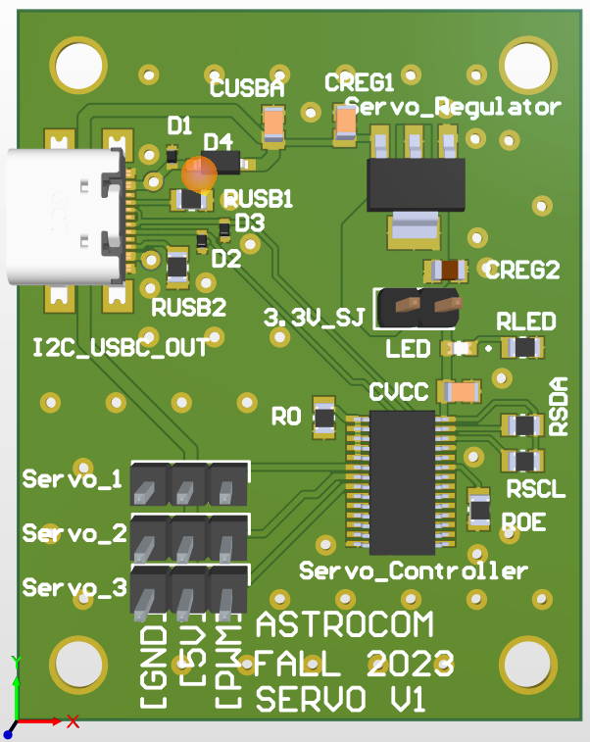
SErVo Motor controller PCB

Slide 46
Administrative Contents
Electrical Engineering | Responsibilities
Alexandre Fiset | PSU Design and Implementation
 | PCB Design
 | MPPT Tracking Implementation
 | Administrative Documentation
Computer Engineering | Responsibilities
Binh Pham | Reflector Technology and Design
 | Motor and Motor Controls
 | Vectoring Technology
 | Project Lead
 | Positioning and Vectoring Algorithm
Computer Engineering | Responsibilities
Pedro Kasprzykowski | MCU Selection and Implementation
 | Software Design and Implementation
 | Antenna and Communications
 | Website Design and Management
Computer Engineering | Responsibilities
Stephen Martin | Sensor Selection and Implementation
 | MCU Selection and Implementation
 | Positioning and Vectoring Algorithm
 | Software Design and Implementation
Distribution of work table

Slide 47
Mechanical's Budgets
Component | Name | Price/unit | Quantity
Mirror | 0.032" x 24" x 24", 3003-H14 Aluminum Sheet | $28.86 | 1
Mirror Coating | Mylar Sheet | $25.99 | 1
Frame | ADJ LTS-6 T-Bar Tripod Lightweight Lighting Stand | $54.99 | 1
Base Panels | Plywood Panels 4ftx8ft | $25.60 | 2
Communication Tower Box | Junction Box | $26.89 | 1
Wheel Hub Bearing | Rear Wheel Hub | $44.90 | 1

Slide 48
Electrical’s Budget
Component | Name | Price | Quantity
Battery | Howell Energy hw-4f7 | 32.99 | 1
Motor w | Nema 23 | $30.73 | 1
Motor x-y-z | 9.5-11kg*cm Servo Motor | $17.59 | 3
Charge Controller/BMS | Smaraad SR11004 | $39.99 | 1
Solar Panel | RNG-50D-SS | $49.99 | 1
Microcontroller | ESP32-C6-DEVKITC-1-N8 | $9.00 | 1
External Antenna | Wlaniot 2.4G | $17.98 | 2
MicroSD card | 5251 | $4.50 | 2
MicroSD card breakout board+ | 254 | $7.50 | 1

Slide 49
PCB’s Budget
Component | Name | Price | Quantity
Microcontroller for PCB | ESP32-C6-WROOM-1U | $3.48 | 1
Stepper Motor Controller | DRV8833PW | $2.84 | 1
Servos Motor Controller | PCA9685PW,112 | $2.64 | 1
3.3V Regulator | TPS54JA20 | $1.50 | 1
5V Regulator | TPS54JA20 | $1.50 | 1
USB-A Connector | 2057-USB-AP-S-RA-SMT-ND | $0.55 | 3
Sensor-MUX | TCA9548APWR | $1.78 | 1
Sensor | VEML7700 | $1.88 | 5
USB-to-UART Bridge Controller | CP2102N-A02-GQFN28 | $4.07 | 1
MicroSD Socket | 1660 | $1.95 | 1
Misc. | Resistors, Capacitors, Inductr, Jumpers, Etc.…. | ~$20.00

